Slide 1
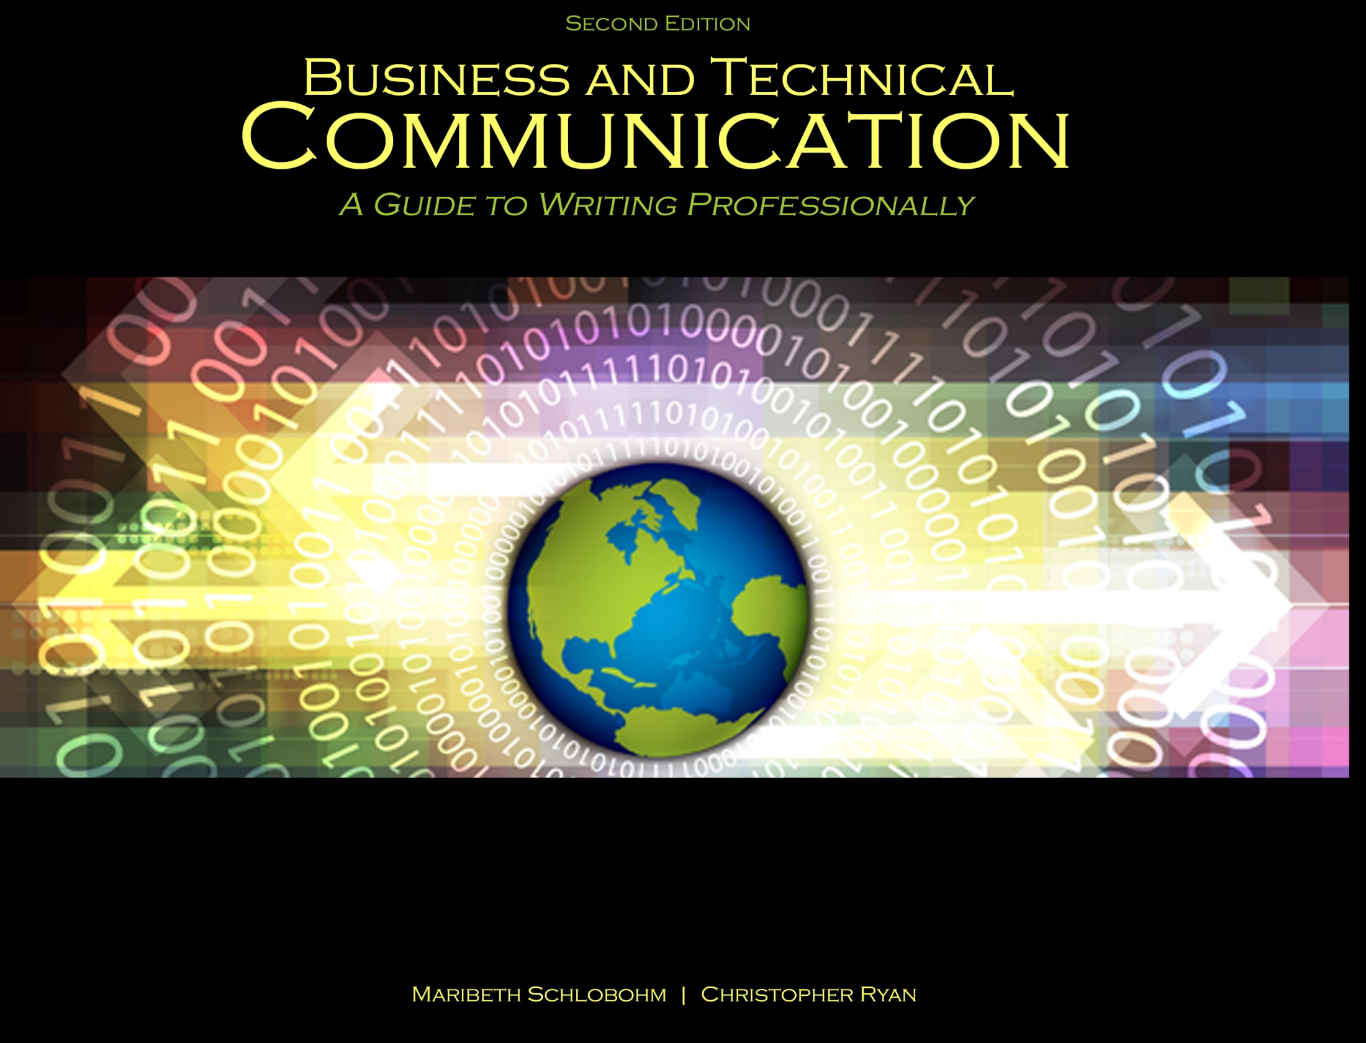
Chapter 6: Reports, Proposals, and White Papers

Slide 2

Common Elements
Reports, Proposals, and White Papers share common elements:
Front matter
Back matter

Slide 3
Front Matter Elements
Cover
Title fly
Letter/Memo of Authorization
Letter/Memo of Acceptance
Letter/Memo of Transmittal
Table of Contents
List of Illustrations
Executive Summary

Slide 4
Cover and Title Fly
Cover Elements:
Title
Prepared for:
Prepared by:
Date (of submission)
Title Fly – title only. Used for formal documents, i.e., Annual Reports

Slide 5
Letters/Memos
Letters – used for external, formal communication
Memos – used for internal, informal comm.
Authorization – authorizes action, i.e., project
Acceptance – accepts/confirms project participation
Transmittal – accompanies project deliverables

Slide 6
Executive Summary
Summarizes entire report and includes:
Purpose statement
Scope and limitations
Methodology
Results
Discussion
Conclusions and recommendations

Slide 7
Back Matter Elements
References – APA, MLA, IEEE, AMA, Chicago
Appendices – including: diagrams, site plans, schematics, drawings, calculations, resumes, and financials
Glossaries – business and technical terminology
Indexes – alphabetical lists of key words

Slide 8
Reports
Purpose – documentation of projects from start to finish
Four Most Common Types:
Feasibility
Status
Lab/test
Final

Slide 9
Feasibility Report Elements
Industry background
Problem statement
Options available
Assessment of options, including:
Risk assessment
Costs and benefits
Alignment with desired business objectives
Fit to project constraints in RFP
Recommendations, including best option and rationale

Slide 10
Lab/Test Report Elements
Test title
Statement of the problem
Hypothesis/Hypotheses
Materials list
Procedure
Results/outcomes
Conclusions
Notes

Slide 11
Status Report Elements
Introduction
Purpose
Specific objectives
Scope and limitations
Dates of project start and scheduled completion
Names of team members, including contact information
Company/organization project is being completed
Body
Status of project – work done, in progress, and to be done
Discussion of current problems and potential solutions
Conclusion
Work is on schedule
Recommendations for change orders

Slide 12
Final Project Report Elements
Front Matter and Back Matter may be extensive
Informal ➔ Formal
Title
Introduction
Background
Scope
Limitations

Slide 13
Final Project Report Elements cont.
Discussion
Current market conditions
Laws and regulations
Codes and standards
Deliverables
Costs and benefits
Future add-ons and developments
marketability
Conclusions and recommendations

Slide 14
Proposals: Overview
Proposal = Persuasion
Informal ➔ Formal
Request for Proposal (RFP)
Municipality, state, and federal projects
Bidding process
Open vs. Closed
Closed bid – only certain contractors are asked for a bid
Open bid – all contractors are given an opportunity to bid
Solicited vs. Unsolicited

Slide 15
Proposal Elements
Introduction
Background
Scope
Limitations
Discussion
Market trends and developments
Problems and solutions
Costs and benefits
Qualifications of team and company
Conclusion and recommendations

Slide 16
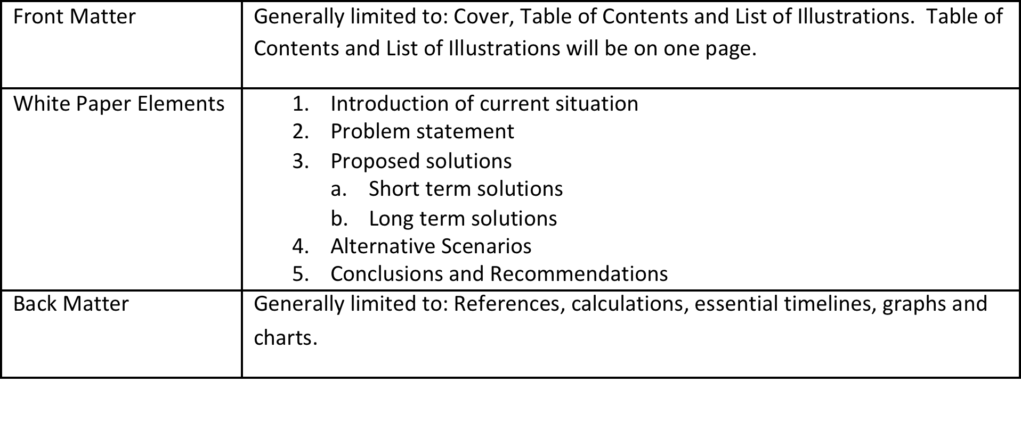
White Paper Elements

Slide 17
References
Schlobohm, Maribeth and Christopher Ryan. Business and Technical Communication: A Guide to Writing Professionally, 2nd Ed., Dubuque, IA: Kendall-Hunt, 2014. Print.

Slide 18
Contact Information
Kendall-Hunt Publishing Company
4050 Westmark Drive
Dubuque, IA 52004-1840
http://www.kendallhunt.com
Toll Free: 800-228-0810

